Slide 1

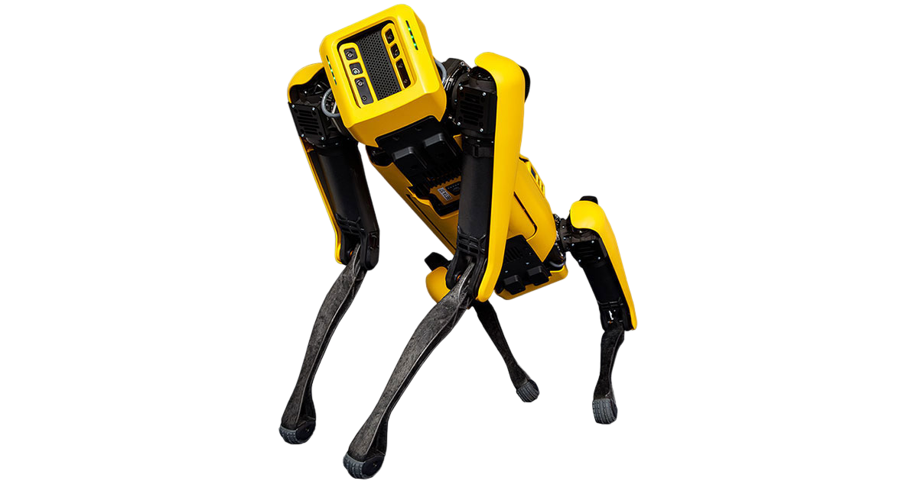
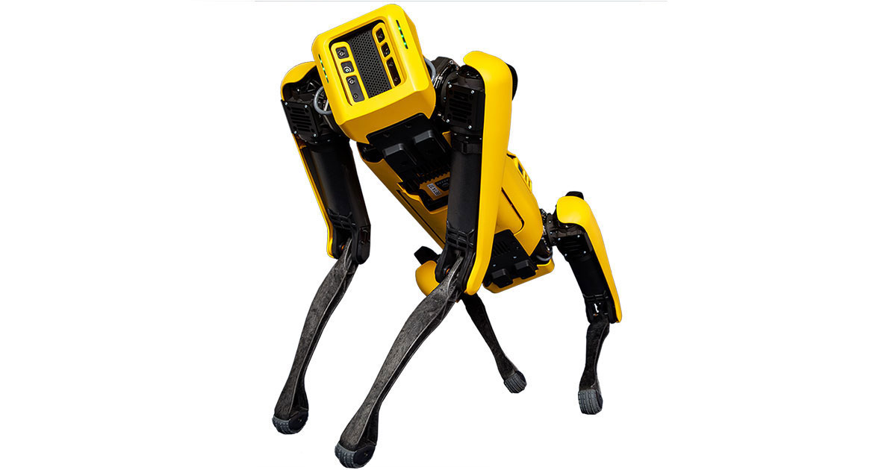
Learning interpretable reduced-order dynamic models for quadruped robots
Name:
Gioele Buriani
Supervisors:
Dr. Cosimo Della Santina

Slide 2
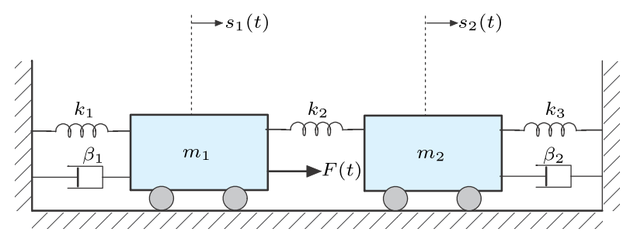
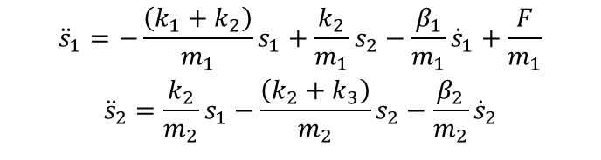
Learn?
2-dimensional continuous system
Classic mechanical modelling
$${\ddot{s}}_{1}=−\frac{\left(k_{1}+k_{2}\right)}{m_{1}}s_{1}+\frac{k_{2}}{m_{1}}s_{2}−\frac{β_{1}}{m_{1}}{\dot{s}}_{1}+\frac{F}{m_{1}}$$
$${\ddot{s}}_{2}=\frac{k_{2}}{m_{2}}s_{1}−\frac{\left(k_{2}+k_{3}\right)}{m_{2}}s_{2}−\frac{β_{2}}{m_{2}}{\dot{s}}_{2}$$
Notes:
Newton’s laws of motion
Free body diagram

Slide 3
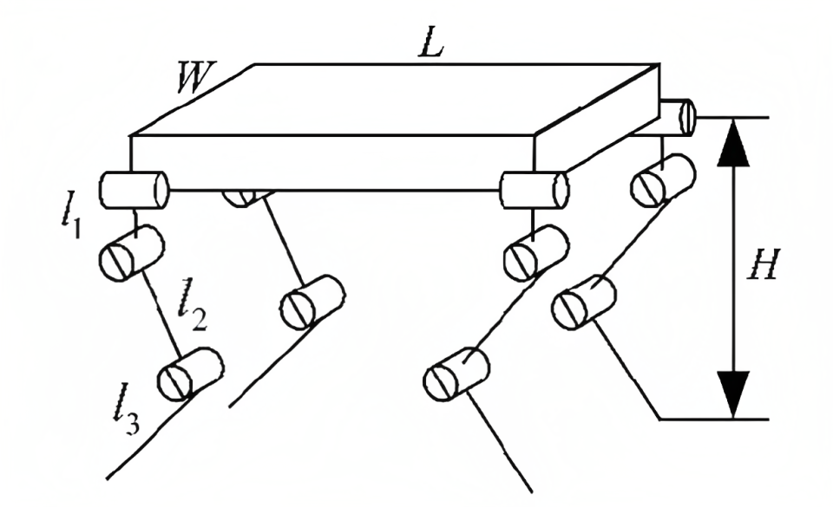
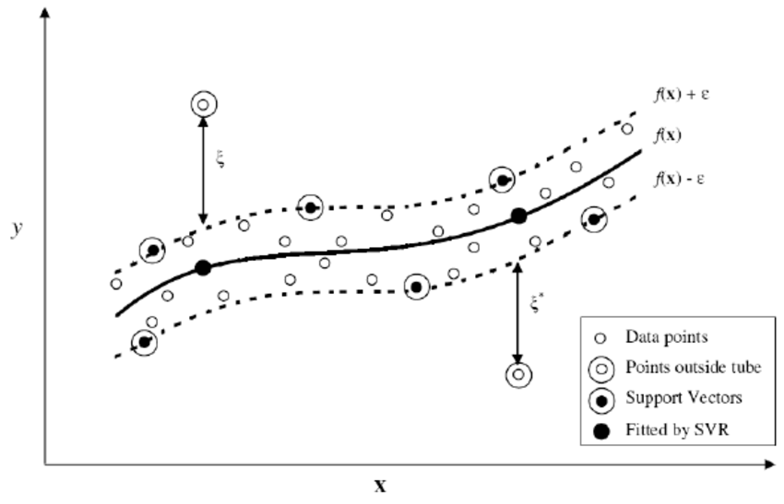
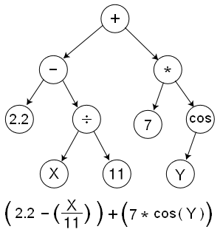
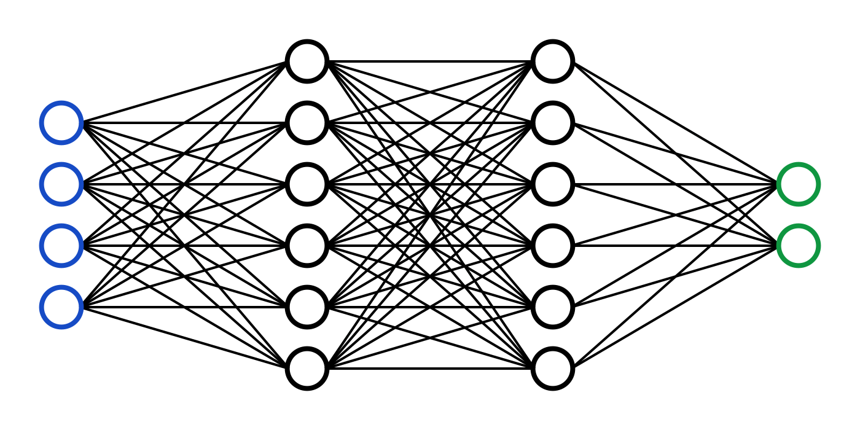
Learn?
20-dimensional hybrid system
Model learning

Slide 4
Outline
“Learning interpretable reduced-order dynamic models for quadruped robots”
Introduction to quadruped robots
Overview on model learning
Dimensionality reduction with Autoencoders
Learning with Symbolic regression
Proposed framework
Quadruped robots
Model learning
Autoencoders
Symbolic regression
Proposed framework

Slide 5
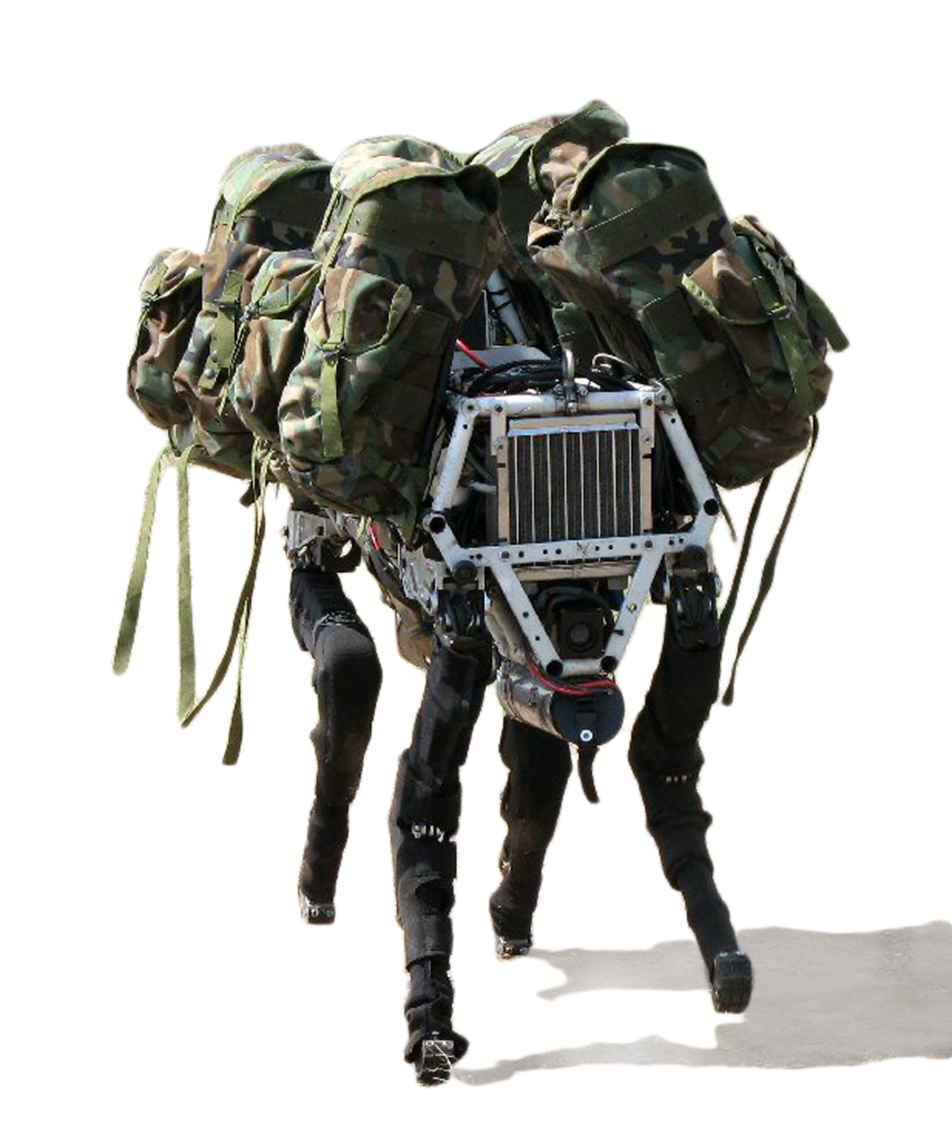
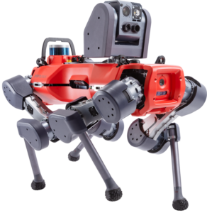
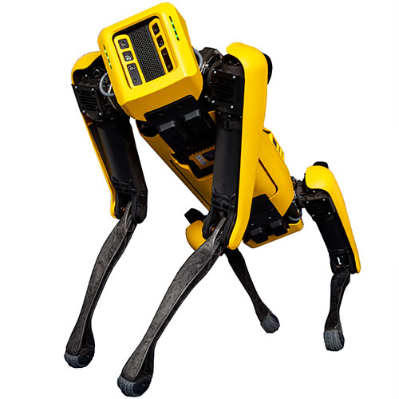
Quadruped robots
Quadruped robots
Model learning
Autoencoders
Symbolic regression
Proposed framework
Big Dog by Boston Dynamics (2008)
ANYmal by ANYbotics (2016)
Spot by Boston Dynamics (2016)

Slide 6
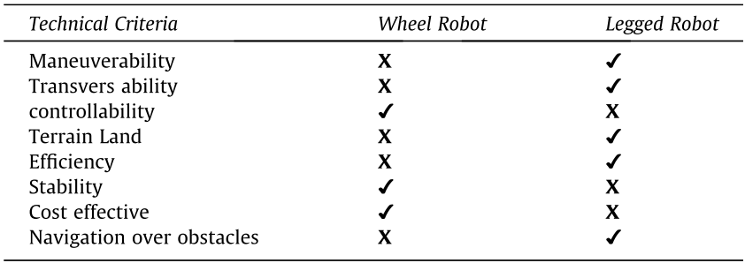
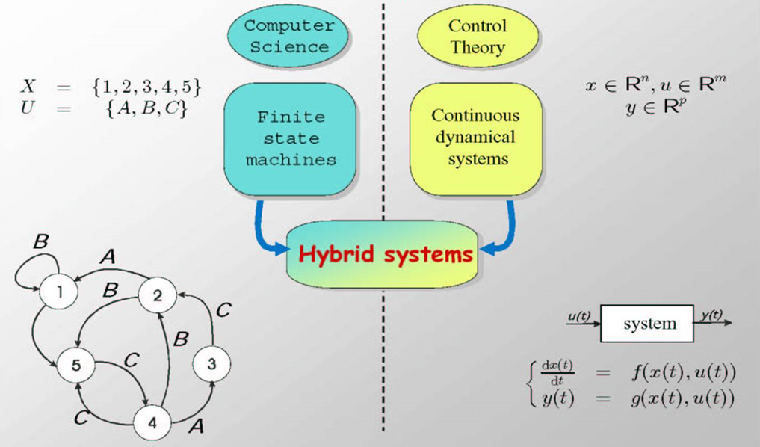
Legged locomotion
Quadruped robots
Model learning
Autoencoders
Symbolic regression
Proposed framework
≈20 dimensions
+
Hybrid system!

Slide 7
Template models
Full order model
Pros
Contains all the information of the system
Cons
Almost impossible to calculate «by hand»
Not always provided by the company
Very difficult to handle (high dimension)
Template models
Pros
Very simple to handle
Cons
Ignores minor dynamics of the system that might be relevant
Quadruped robots
Model learning
Autoencoders
Symbolic regression
Proposed framework

Slide 8
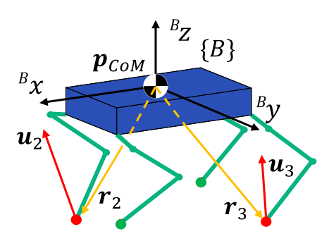
Template models
Full order model
Pros
Contains all the information of the system
Cons
Almost impossible to calculate «by hand»
Not always provided by the company
Very difficult to handle (high dimension)
Template models
Pros
Very simple to handle
Cons
Ignores minor dynamics of the system that might be relevant
Quadruped robots
Model learning
Autoencoders
Symbolic regression
Proposed framework
Single Rigid Body
Notes:
Combines the body and legs into one structure. It uses ground reaction forces to control position and orientation, effectively capturing the impact of external forces. It is preferred for real-time constraints and is a good approximation as leg mass is typically less than 10% of the total mass.

Slide 9
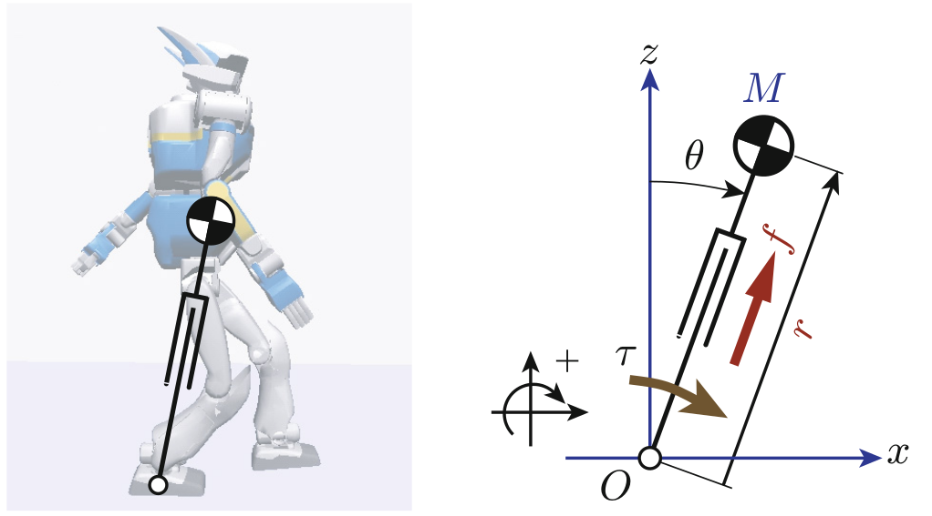
Template models
Full order model
Pros
Contains all the information of the system
Cons
Almost impossible to calculate «by hand»
Not always provided by the company
Very difficult to handle (high dimension)
Template models
Pros
Very simple to handle
Cons
Ignores minor dynamics of the system that might be relevant
Single Rigid Body
Quadruped robots
Model learning
Autoencoders
Symbolic regression
Proposed framework
Linear Inverted Pendulum
Notes:
Used for studying quadruped robots' static gaits. It represents the robot as a point mass on a lightweight leg, offering analytical tractability and insights into important behaviors. It is commonly used for legged robots with a heavy upper body and lightweight legs, ensuring computational efficiency and physical feasibility in motion planning.

Slide 10
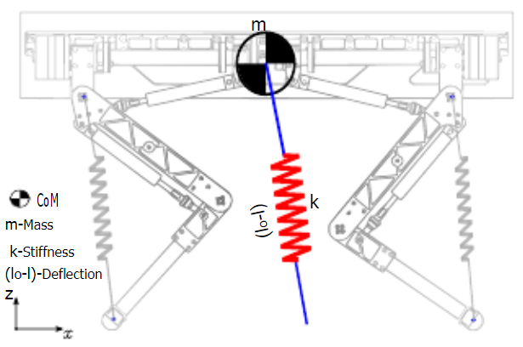
Template models
Full order model
Pros
Contains all the information of the system
Cons
Almost impossible to calculate «by hand»
Not always provided by the company
Very difficult to handle (high dimension)
Template models
Pros
Very simple to handle
Cons
Ignores minor dynamics of the system that might be relevant
Single Rigid Body
Quadruped robots
Model learning
Autoencoders
Symbolic regression
Proposed framework
Spring Loaded Inverted Pendulum
Linear Inverted Pendulum
Notes:
Used for dynamic gait modeling of robots. It represents the quadruped as a single rigid body supported by a spring-damper leg. The SLIP model accurately captures center of mass dynamics during hopping and running, simplifying analysis without considering the complexities of a full multi-body system.

Slide 11
Template models
Full order model
Pros
Contains all the information of the system
Cons
Almost impossible to calculate «by hand»
Not always provided by the company
Very difficult to handle (high dimension)
Template models
Pros
Very simple to handle
Cons
Ignores minor dynamics of the system that might be relevant
Single Rigid Body
Quadruped robots
Model learning
Autoencoders
Symbolic regression
Proposed framework
Linear Inverted Pendulum
Spring Loaded Inverted Pendulum

Slide 12
Model learning
Machine Learning
Quadruped robots
Model learning
Autoencoders
Symbolic regression
Proposed framework
System
System model

Slide 13
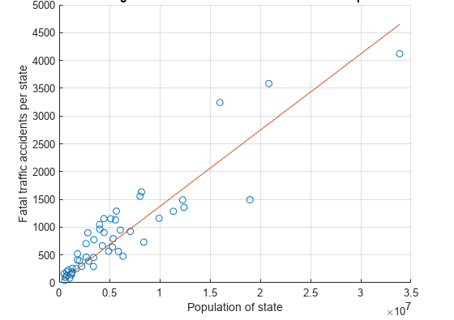
Classic techniques
Linear Regression
Quadruped robots
Model learning
Autoencoders
Symbolic regression
Proposed framework
Notes:
Type of regression analysis that models the relationship between a dependent variable and one or more independent variables using a linear equation.

Slide 14
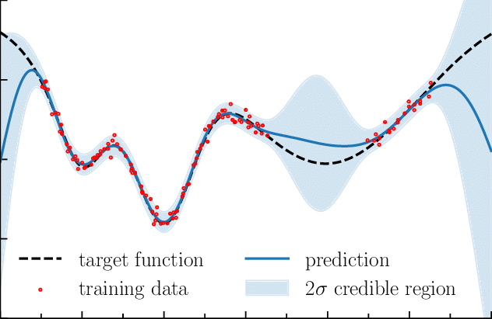
Classic techniques
Linear Regression
Gaussian Regression
Quadruped robots
Model learning
Autoencoders
Symbolic regression
Proposed framework
Notes:
Uses Gaussian processes (GPs) to model the relationship between input and output variables. GPs represent a collection of random variables with joint Gaussian distributions, enabling flexible and non-parametric modeling of complex relationships without assuming a specific functional form.

Slide 15
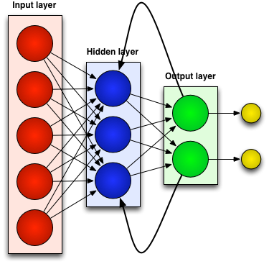
Classic techniques
Linear Regression
Gaussian Regression
Recurrent Neural Networks
Quadruped robots
Model learning
Autoencoders
Symbolic regression
Proposed framework
Notes:
Uses Gaussian processes (GPs) to model the relationship between input and output variables. GPs represent a collection of random variables with joint Gaussian distributions, enabling flexible and non-parametric modeling of complex relationships without assuming a specific functional form.

Slide 16
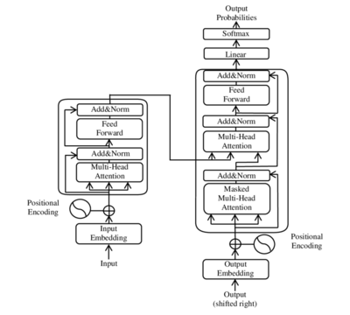
Classic techniques
Linear Regression
Gaussian Regression
Recurrent Neural Networks
Transformers
Quadruped robots
Model learning
Autoencoders
Symbolic regression
Proposed framework
Notes:
Uses Gaussian processes (GPs) to model the relationship between input and output variables. GPs represent a collection of random variables with joint Gaussian distributions, enabling flexible and non-parametric modeling of complex relationships without assuming a specific functional form.

Slide 17
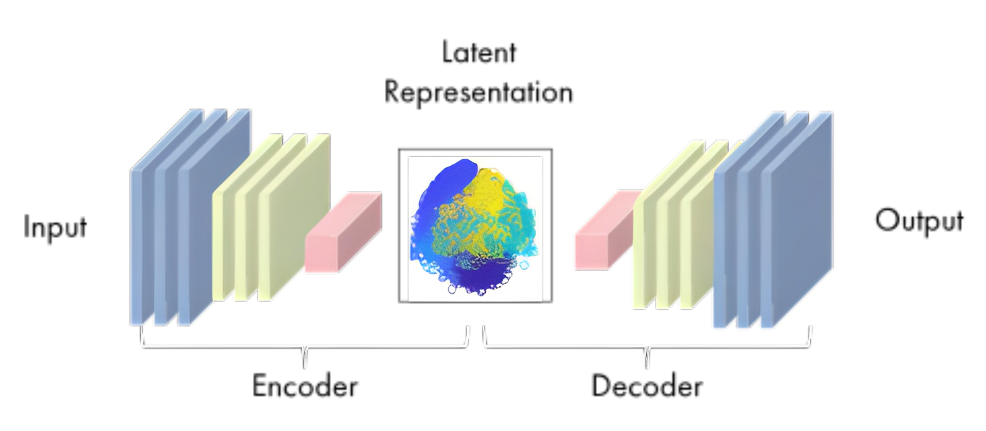
Autoencoders
Self-supervised neural networks
Quadruped robots
Model learning
Autoencoders
Symbolic regression
Proposed framework

Slide 18
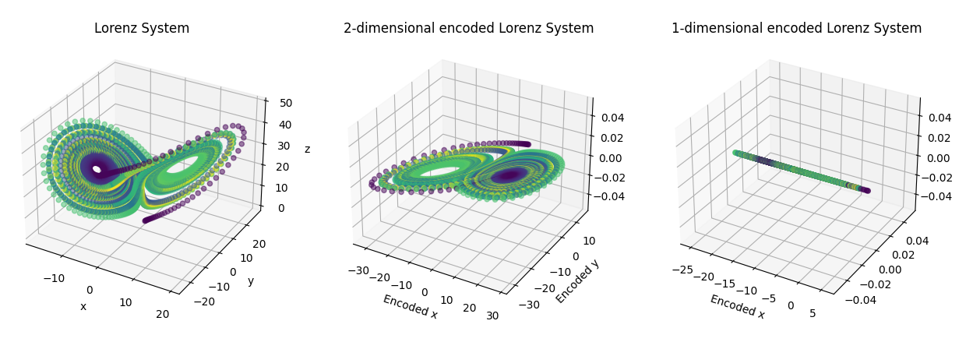
Lorenz System example
Quadruped robots
Model learning
Autoencoders
Symbolic regression
Proposed framework

Slide 19
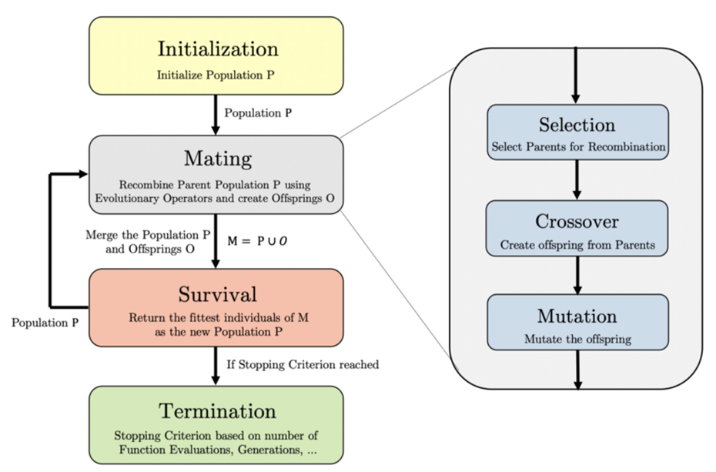
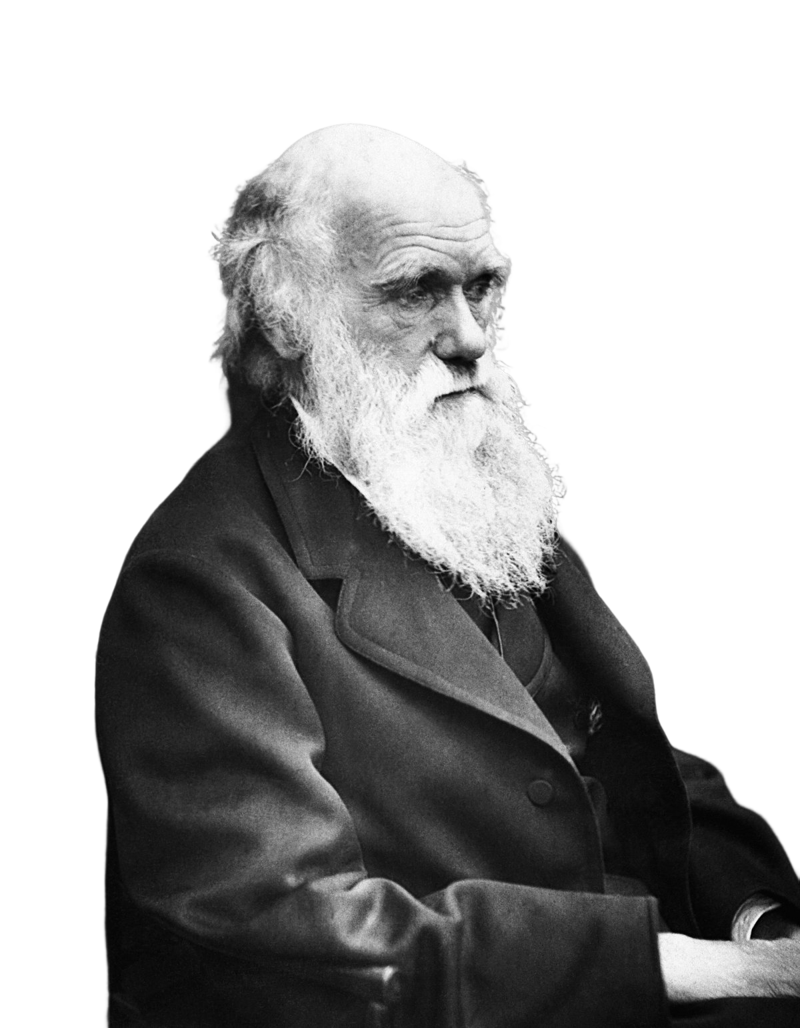
Genetic programming
Symbolic regression based on evolutionay algorithms:
Quadruped robots
Model learning
Autoencoders
Symbolic regression
Proposed framework

Slide 20
Symbolic regression
Initialize population of expressions.
Evaluate fitness of expressions.
Select fit individuals for reproduction.
Apply mutation and crossover.
Evaluate fitness of offspring.
Repeat for multiple generations.
Quadruped robots
Model learning
Autoencoders
Symbolic regression
Proposed framework

Slide 21
Proposed framework
Quadruped robots
Model learning
Autoencoders
Symbolic regression
Proposed framework
Quadruped robot

Slide 22
Proposed framework
“Learning interpretable reduced-order dynamic models for quadruped robots”
Quadruped robots
Model learning
Autoencoders
Symbolic regression
Proposed framework
Quadruped robot

Slide 23

Proposed framework
“Learning interpretable reduced-order dynamic models for quadruped robots”
Quadruped robots
Model learning
Autoencoders
Symbolic regression
Proposed framework
Input-output data
Quadruped robot

Slide 24
Proposed framework
Quadruped robots
Model learning
Autoencoders
Symbolic regression
Proposed framework
Autoencoder

Slide 25
Proposed framework
“Learning interpretable reduced-order dynamic models for quadruped robots”
Quadruped robots
Model learning
Autoencoders
Symbolic regression
Proposed framework
Input-output data
Quadruped robot

Slide 26
Proposed framework
“Learning interpretable reduced-order dynamic models for quadruped robots”
Quadruped robots
Model learning
Autoencoders
Symbolic regression
Proposed framework
Input-output data
Quadruped robot
Latent representation

Slide 27
Proposed framework
Quadruped robots
Model learning
Autoencoders
Symbolic regression
Proposed framework
Symbolic regression

Slide 28
Proposed framework
“Learning interpretable reduced-order dynamic models for quadruped robots”
Quadruped robots
Model learning
Autoencoders
Symbolic regression
Proposed framework
Input-output data
Quadruped robot
Symbolic regression
Latent representation

Slide 29
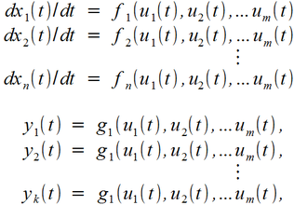
Proposed framework
“Learning interpretable reduced-order dynamic models for quadruped robots”
Quadruped robots
Model learning
Autoencoders
Symbolic regression
Proposed framework
Input-output data
Quadruped robot
Reduced-order interpretable dynamic model
Symbolic regression
Latent representation

Slide 30
Thank you for your time!

Slide 31
Classic techniques
Linear Regression
Quadruped robots
Model learning
Autoencoders
Symbolic regression
Proposed framework
Notes:
Type of regression analysis that models the relationship between a dependent variable and one or more independent variables using a linear equation.

Slide 32
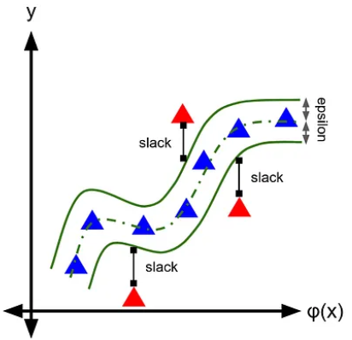
Classic techniques
Linear Regression
Support Vector Regression
Quadruped robots
Model learning
Autoencoders
Symbolic regression
Proposed framework
Notes:
Uses Support Vector Machines (SVMs) to model non-linear relationships between input features and output variables. It aims to find a hyperplane, in the form of a regression line or curve, that closely fits the data while minimizing prediction error within a specific margin or threshold.

Slide 33
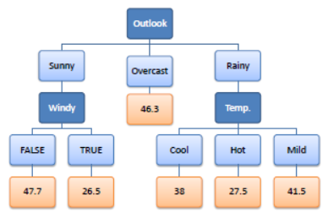
Classic techniques
Linear Regression
Support Vector Regression
Decision Tree Regression
Quadruped robots
Model learning
Autoencoders
Symbolic regression
Proposed framework
Notes:
Non-parametric supervised learning technique that models the relationship between input features and output values using a tree-like structure. It partitions the dataset, creating decision nodes with rules and leaf nodes with output predictions. Trained decision trees can predict output values for new inputs by following the decision rules.

Slide 34
Classic techniques
Linear Regression
Support Vector Regression
Decision Tree Regression
Gaussian Regression
Quadruped robots
Model learning
Autoencoders
Symbolic regression
Proposed framework
Notes:
Uses Gaussian processes (GPs) to model the relationship between input and output variables. GPs represent a collection of random variables with joint Gaussian distributions, enabling flexible and non-parametric modeling of complex relationships without assuming a specific functional form.

Slide 35
Deep Learning
Recurrent Neural Networks
Quadruped robots
Model learning
Autoencoders
Symbolic regression
Proposed framework
Notes:
Neural network architecture specifically designed for sequential data. It maintains an internal state or "memory" that captures information from previous inputs. RNNs achieve this through a feedback loop, allowing information to flow from one step of the sequence to the next.

Slide 36
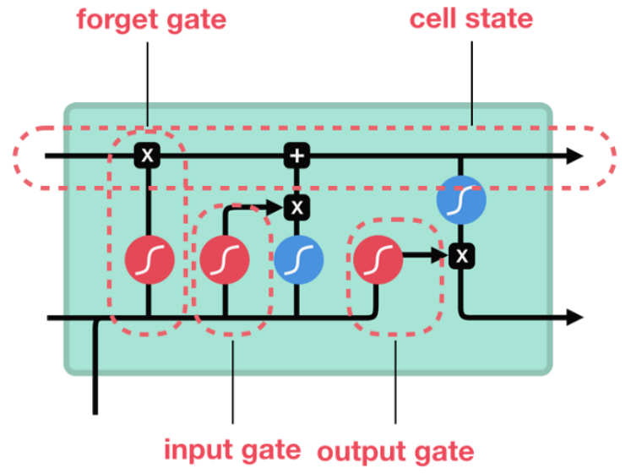
Deep Learning
Recurrent Neural Networks
Long Short-Term Memory Networks
Quadruped robots
Model learning
Autoencoders
Symbolic regression
Proposed framework
Notes:
Have a sophisticated architecture with memory cells and gates that regulate information flow. Memory cells store information for extended periods, while gates control input, output, and memory erasure. LSTMs overcome the vanishing gradient problem in recurrent neural networks by selectively remembering or forgetting information.

Slide 37
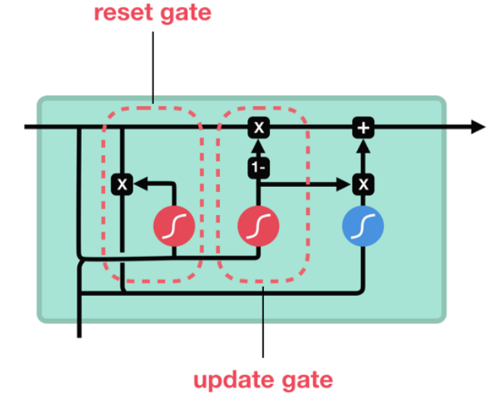
Deep Learning
Recurrent Neural Networks
Long Short-Term Memory Networks
Gated Recurrent Units
Quadruped robots
Model learning
Autoencoders
Symbolic regression
Proposed framework
Notes:
Have a simpler structure than LSTMs, with two gates: an update gate and a reset gate. The update gate controls retention of prior hidden state and inclusion of new input, while the reset gate regulates exclusion of prior hidden state during computation of the new hidden state.

Slide 38
Deep Learning
Recurrent Neural Networks
Long Short-Term Memory Networks
Gated Recurrent Units
Transformers
Quadruped robots
Model learning
Autoencoders
Symbolic regression
Proposed framework
Notes:
Powerful architecture that processes input sequences in parallel using self-attention. It can focus on different parts of the input and capture long-range dependencies effectively, outperforming traditional RNN models.

